Slide 1
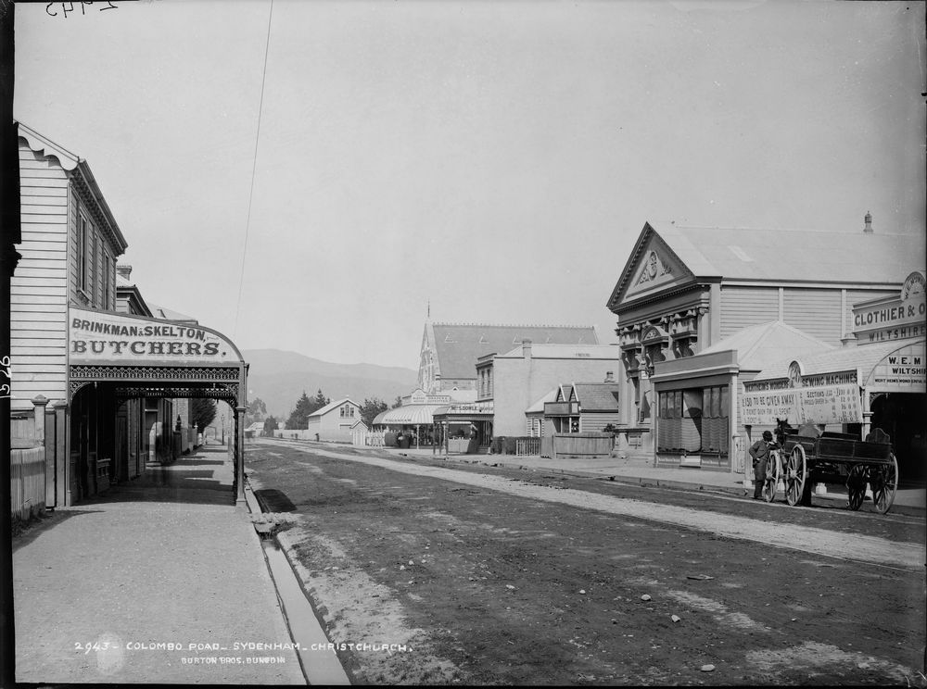
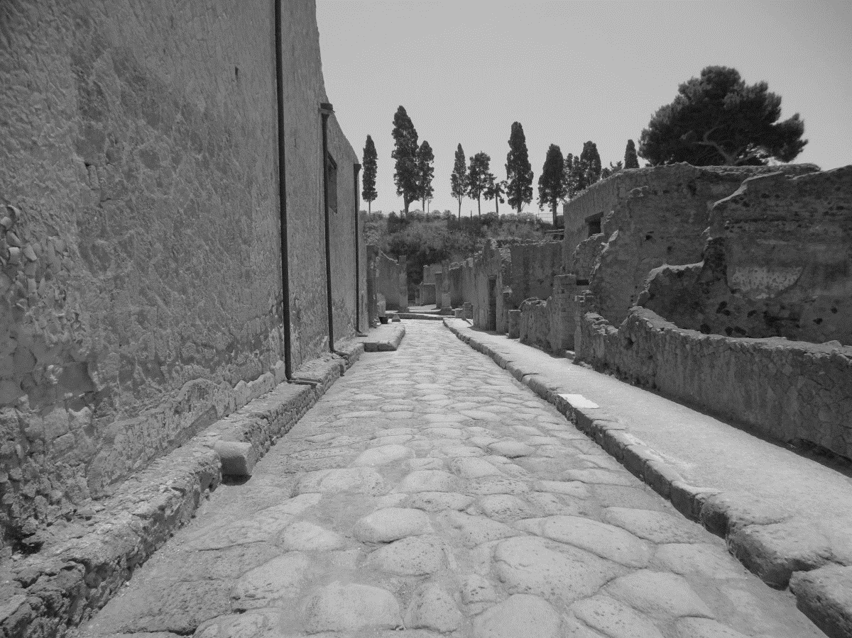
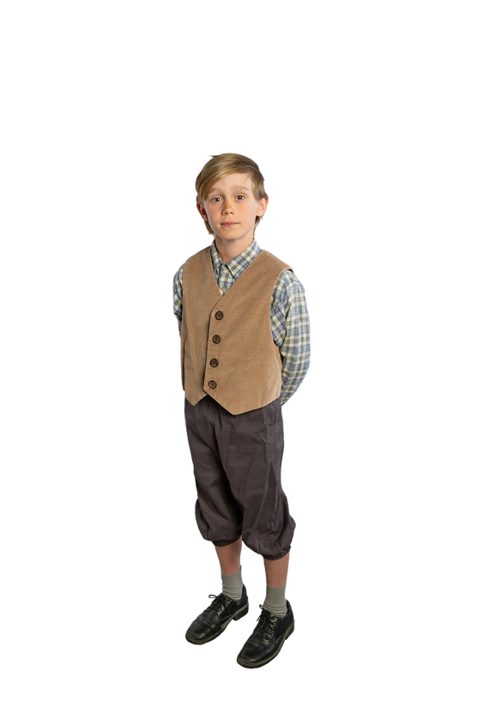
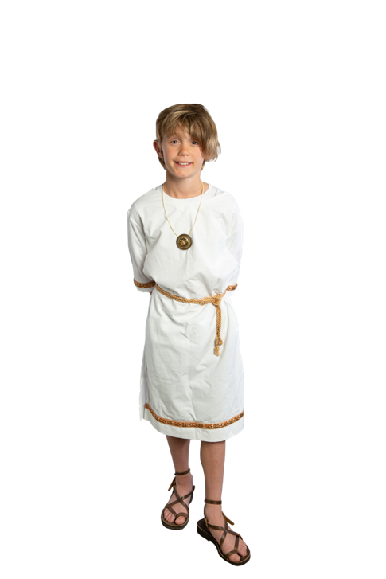
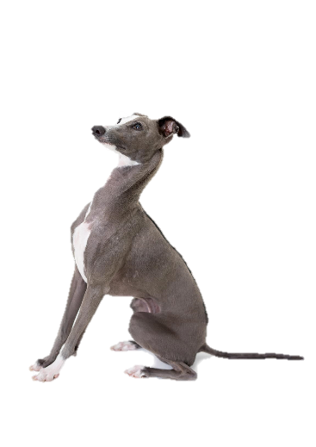
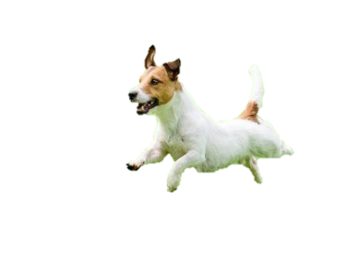
A Day in the Life of….
Scipio
&
Archie
Created by Nicole Pepperell

Slide 2
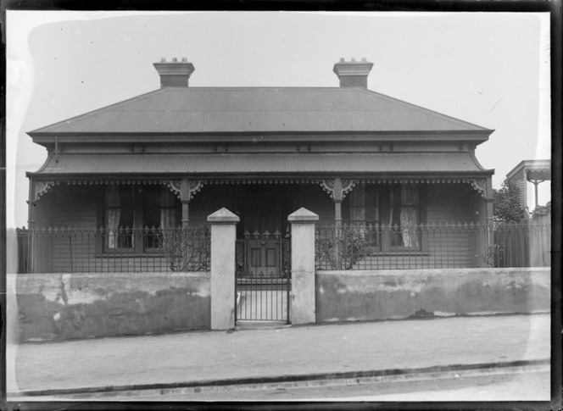
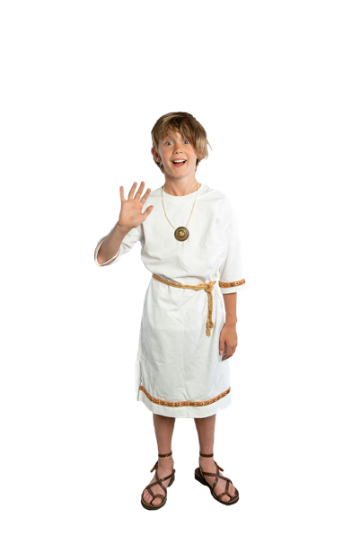
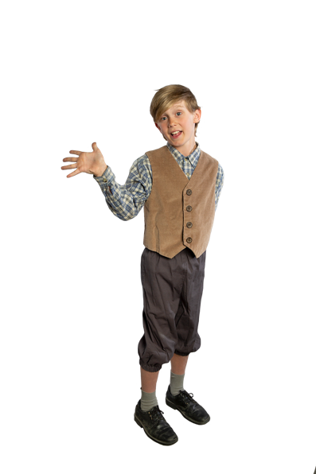
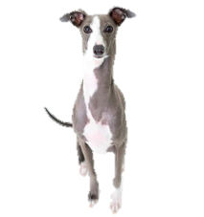
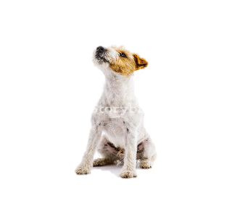
“Salvē! My name’s Scipio! I’m 9 years old and I live in Rome. The year is 50 CE. I live with my parents, my little sister Lucia and two slaves, Agata and Andros. My father works as a lawyer and my mother stays at home. I enjoy playing with my dog Titan and pet parrot Ajax.”
“Hi! I’m Archie and I’m 9 years old. I live in Christchurch, New Zealand. The year is 1890. I live with my mother and father and my brother and sister, Henry and Mary. I go to Sydenham School. My father is a teacher and my mother stays at home. I don’t like homework but I do like to buy sweets and play with my dog, Sparky.”

Slide 3
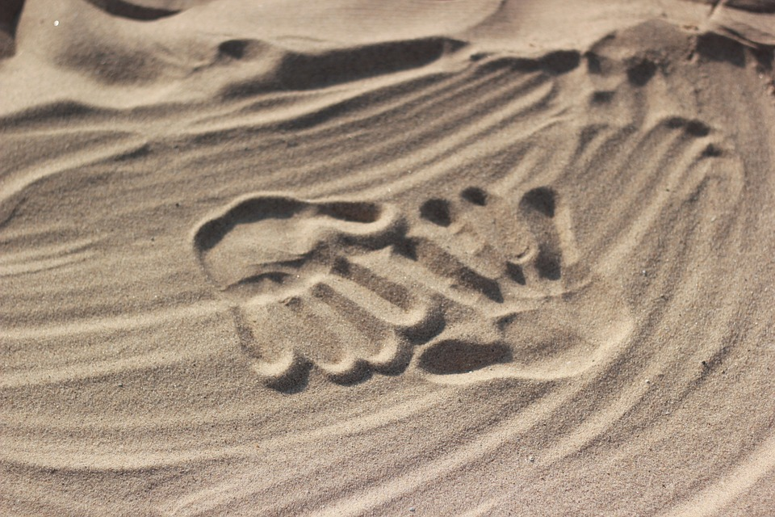
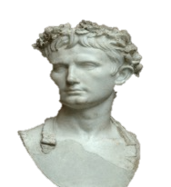
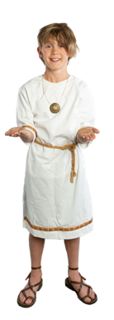
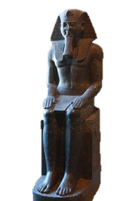
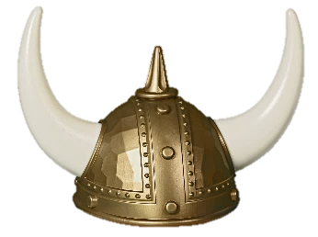
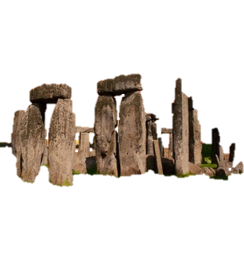
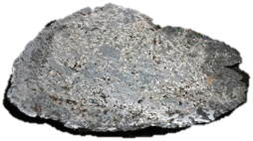
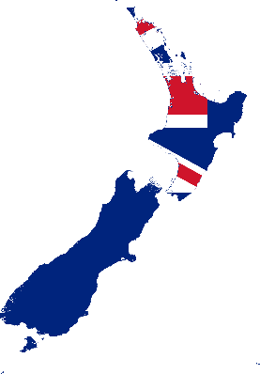
Year 1 BCE (Before the Common Era) refers to the first year before Year 1 CE (Common Era).
What year is it?
The Viking Age in Europe
793-1066 CE
50 CE
The death of Rameses the Great 1213 BCE
Roman Empire
27 BCE – 476 CE
1890 CE
2000 BCE
0
2000 CE
1000 BCE
1000 CE
Captain Cook’s expedition first sighted New Zealand in 1769 CE
Stonehenge is constructed in England ca. 3000-2000 BCE
The Iron Age
ca. 1000 BCE

Slide 4
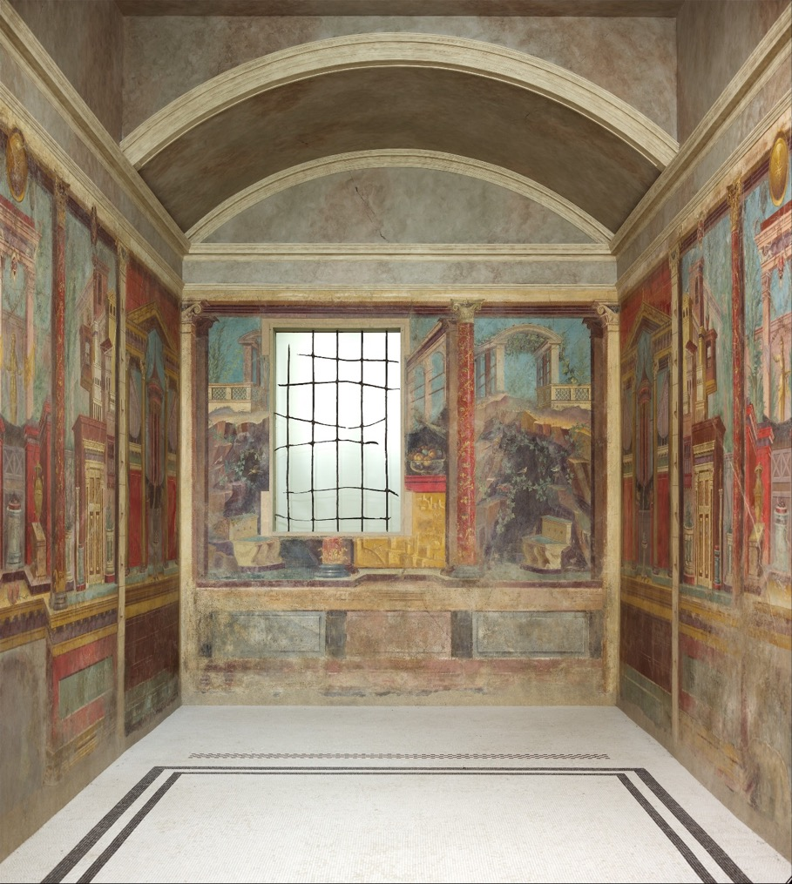
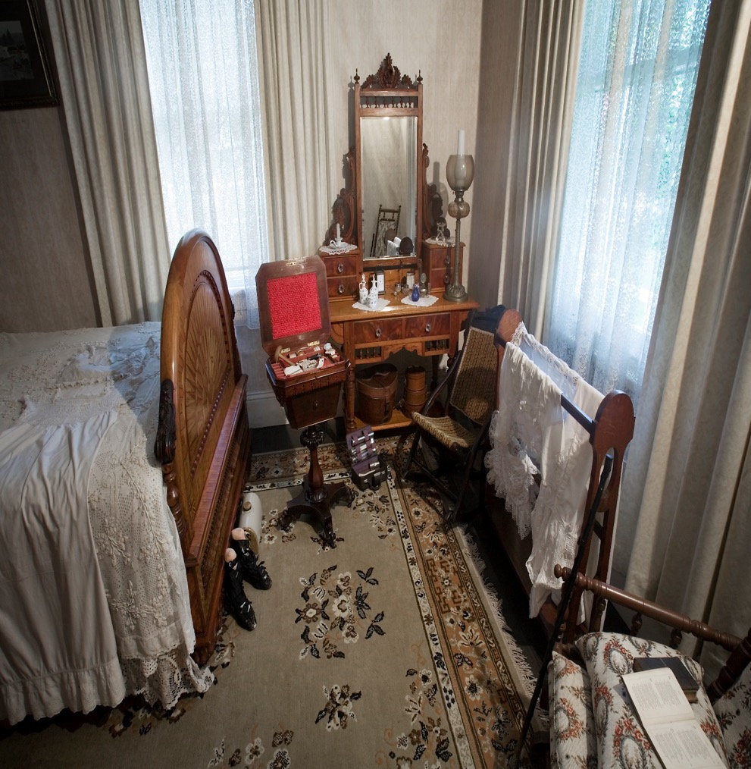
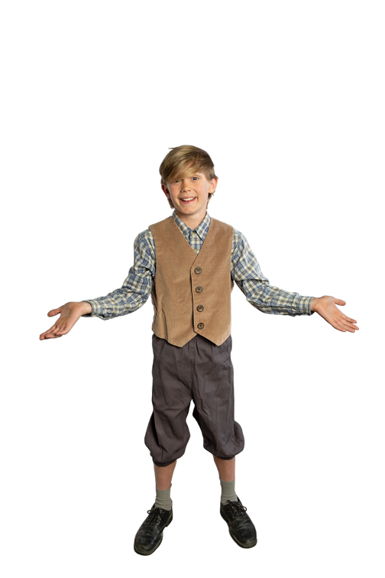
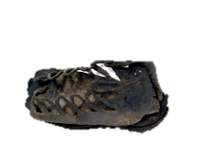
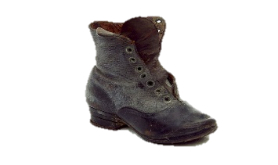
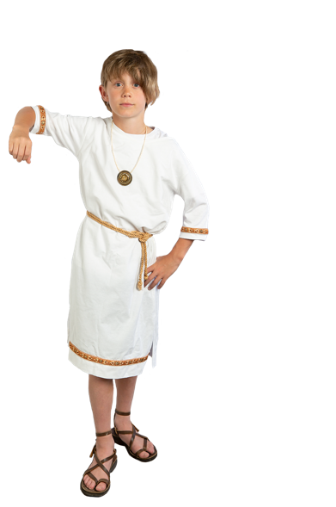
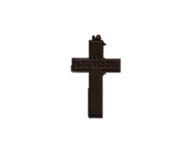
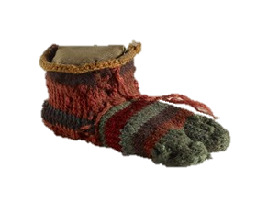
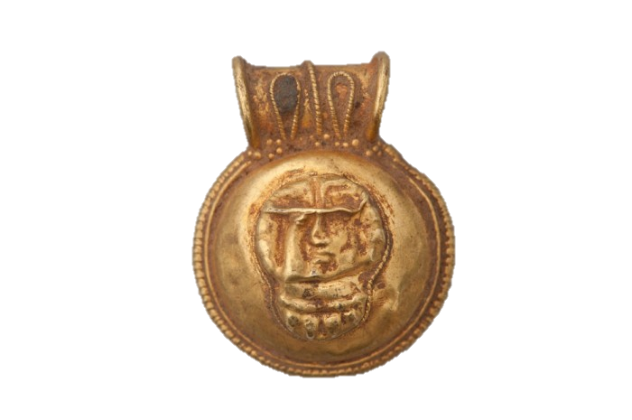
Getting Dressed
“Today I’m going to wear this shirt and my knickerbockers. When I’m 13, I will be allowed to wear long trousers. I wear this cross for protection and I also have to wear my boots because the road to school is always muddy!”
Scipio is woken early by the sounds of the street. He jumps out of bed and begins to get dressed for the day ahead…
“I’m going to wear my woollen tunic and a belt around my waist. When I turn 13, I can wear an adult’s toga. These are my leather sandals, I have lots of pairs. Oops… almost forgot my bulla pendant. My mother says it will help protect me.”
“Cockle doodle doo!” Every morning Archie is woken by Mr Smith’s rooster who lets him know when to get dressed for school…

Slide 5
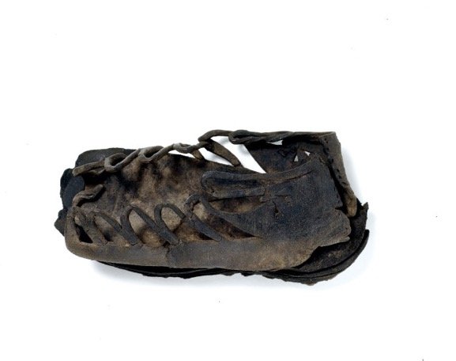
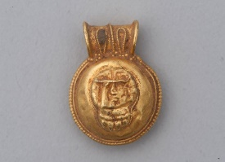
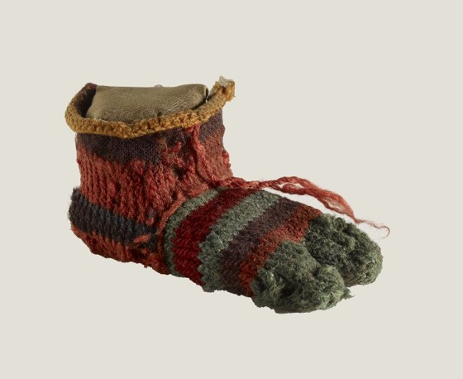
This small Roman leather shoe probably belonged to a child. It was found in a waterlogged deposit on the site of the Bank of England in London.
Child’s Shoe (1935,1106.9), The British Museum, Roman Britain, probably 1st or 2nd century CE.
The gold bulla is framed by crimped wire and has a Gorgon figure on the front. The back of the bulla is dented and is pierced in the centre. The loop was probably filled with stones or glass.
Gold Bulla, (NN), John Hopkins Museum, Etruscan or Roman.
Found in Egypt, this knitted woollen child’s sock was probably made for the left foot. It has a high ankle and two toes, one for the big toe and one for all the other toes.
Sock (1914,1010.15), The British Museum, 3rd-4th century CE.

Slide 6
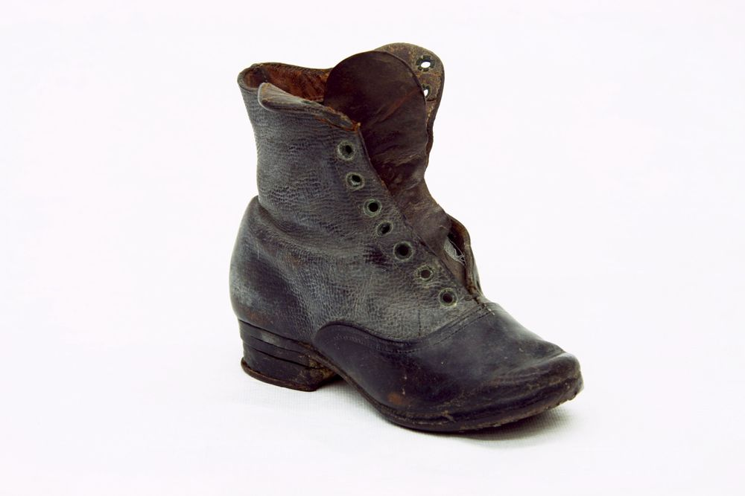
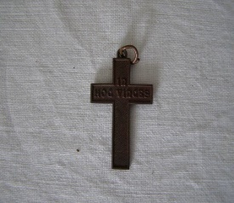
Made in the 1880s, this child’s black leather boot is now missing its laces. The boot is only 6cm wide and 11cm high. Such a small shoe was probably made for a young child.
Child's Boot, circa 1880, maker unknown. CC BY-NC-ND 4.0. Te Papa (PC001396)
This small cross pendant bears the Latin inscription “In Hoc Vinces” (In this sign you will conquer). The Emperor at the time, Constantine I, ordered his soldiers to write the same motto on their shields before battle.
Cross Pendant (2009.70.1), Circa 1800s.
Howick Historic Village, NZ.

Slide 7
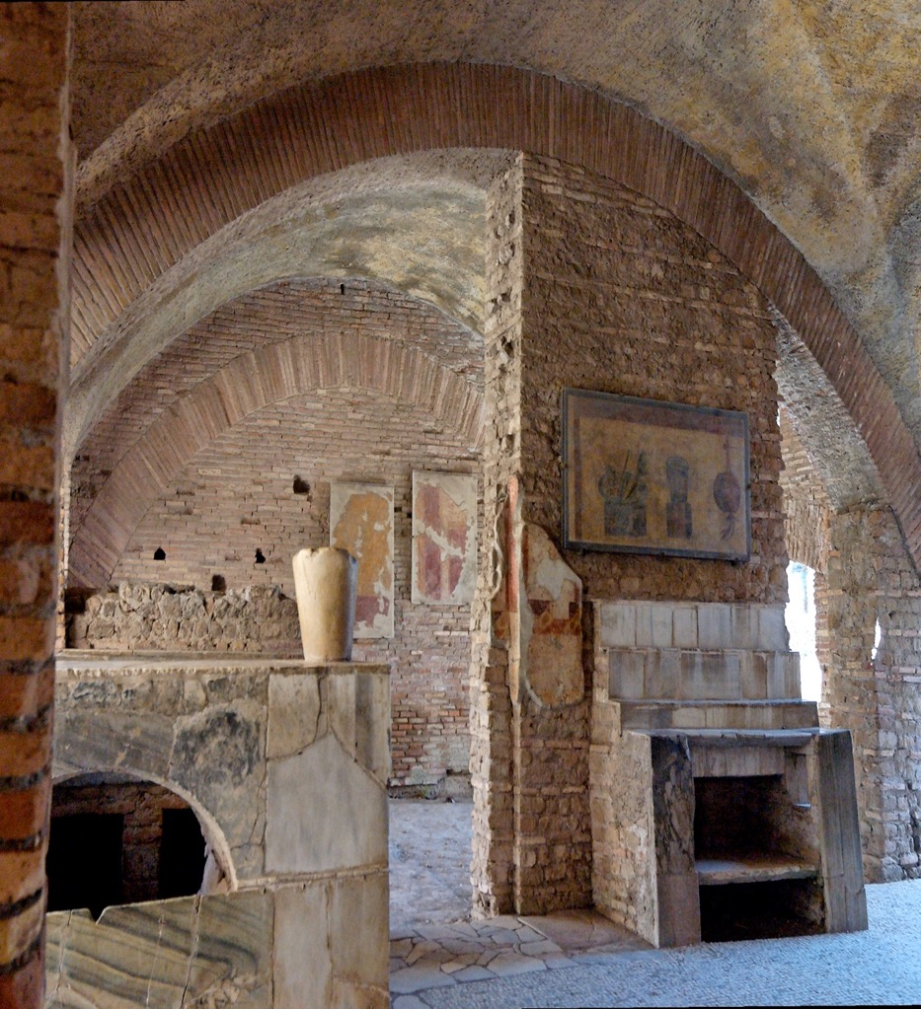
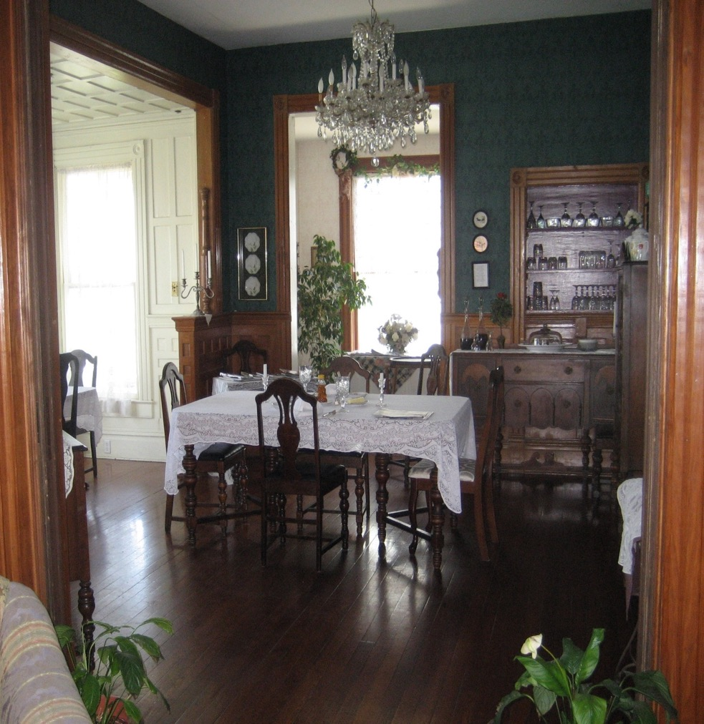
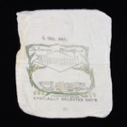
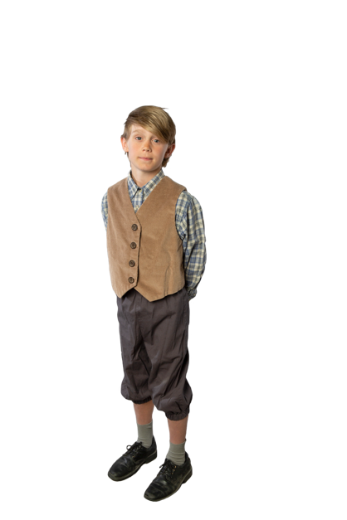
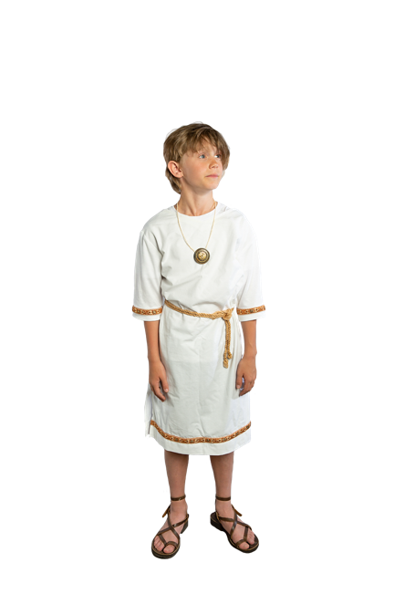
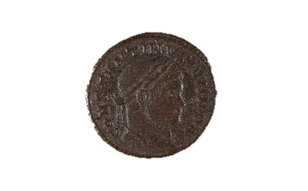
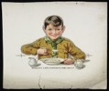
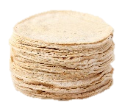
Eating Breakfast
“Aww! Not porridge again! All the boys at school eat porridge too. My teacher says porridge is from Scotland and is the best breakfast for growing boys. But I’d rather eat lots of sweets from Mr. Brown’s shop…”
Once dressed, Scipio says ‘goodbye’ to his parents and walks off to school with his attendant. On the way, he stops at the local shop to buy some breakfast…
“Our family slave Andros walks with me to school to keep me safe. On the way we stop for wheat pancakes at the taberna… they’re so yummy with lots of honey! I like these pancakes better than boiled porridge at home.”
After he has dressed, Archie quickly eats his breakfast at the kitchen table with his family. Archie’s breakfast is normally porridge, which he finds boring!

Slide 8
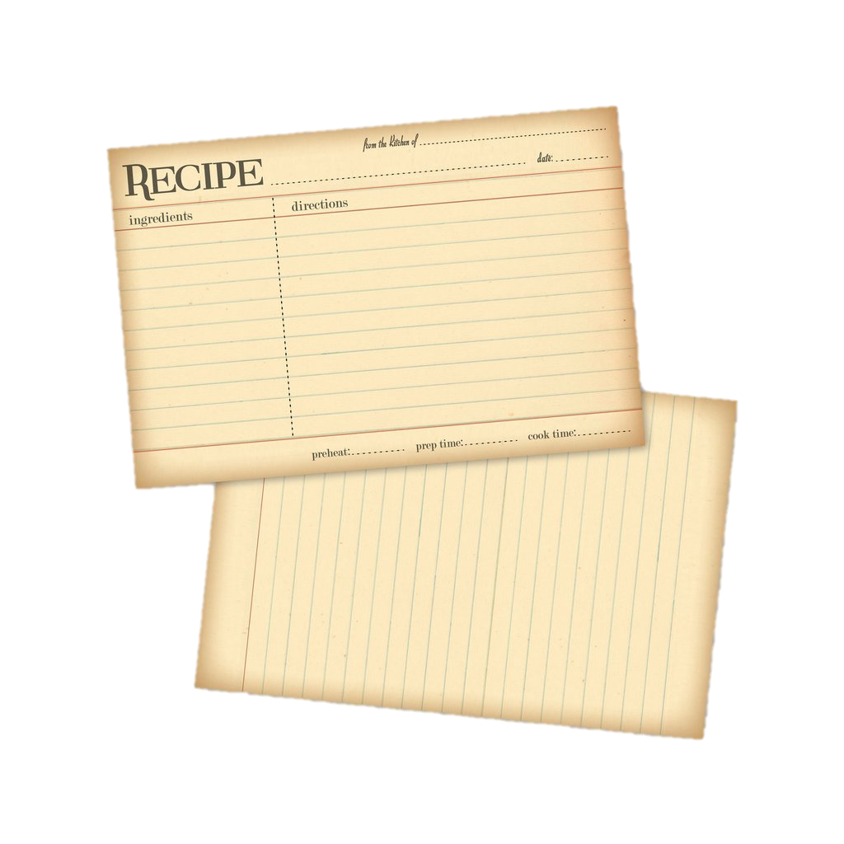
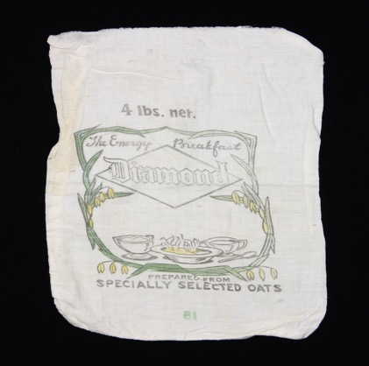
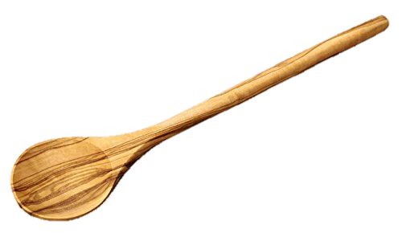
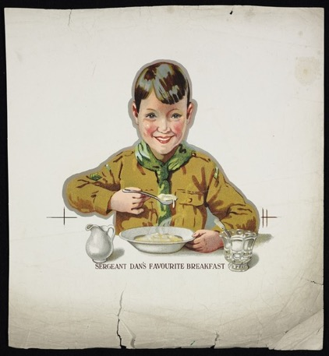
Archie’s Mother
The slogan on this calico bag for oats is “The Energy Breakfast”.
Oats sack, 20th century CE, by Diamond. Gift of Valerie Carson, 2009. CC BY-NC-ND 4.0. Te Papa (GH016341)
Tasty Porridge
1890
Combine oats, milk and 2/3 cup (160ml) water in a small saucepan over medium heat. Bring to the boil. Cook, stirring, for 2-3 minutes or until oats are soft and creamy. Serve.
60g Rolled Oats
160 ml Milk
2/3 cup water
Shopping List
Flour
Oats
Shoe polish
Lard
Mutton
Tripe
Remember sausages for
sparky
5 min
5 min
The boy scout ‘Sergeant Dan’ was used to advertise Creamoata Oats.
[Whitcombe & Tombs Ltd?]: Sergeant Dan's favourite breakfast [1910-1930s]. Ref: Eph-C-FOOD-Whitcombe-2-07. Alexander Turnbull Library, NZ /records/37775272 .

Slide 9
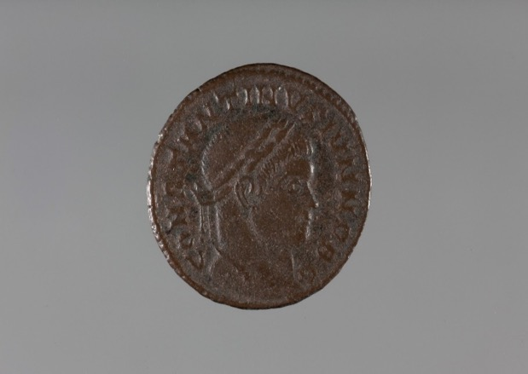
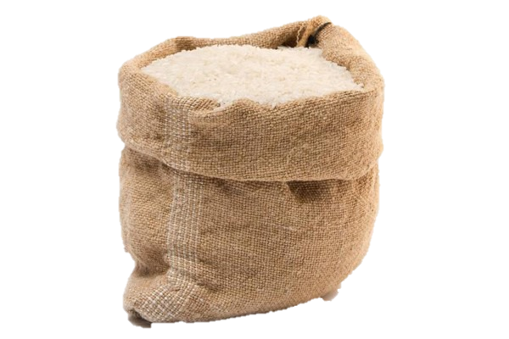
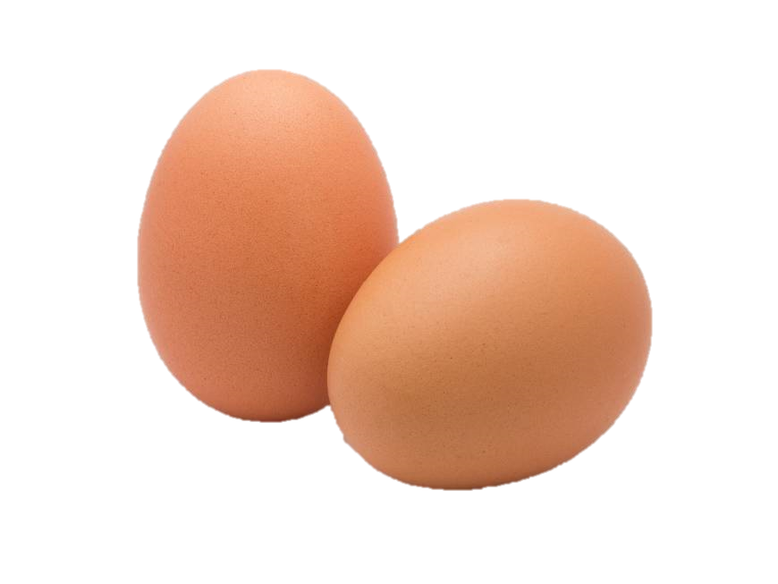
Libum (Cheesecake)
2 lb cheese well crushed in a mortar; when it is well crushed, add in 1lb bread-wheat flour or, if you want it to be lighter, just half a pound, to be mixed with the cheese. Add one egg and mix together well. Make a loaf with this, with leaves under it, and cook slowly in a hot fire under a brick.
- Cato, On Agriculture 75
Constantine II was the eldest son of the Roman Emperor Constantine and his wife Fausta. He was born in August 316 CE, making him around eight years old when this coin was made.
Bronze Follis. Constantine II (JLMC 180.96.34). 323-324 CE. UC James Logie Memorial Collection.

Slide 10
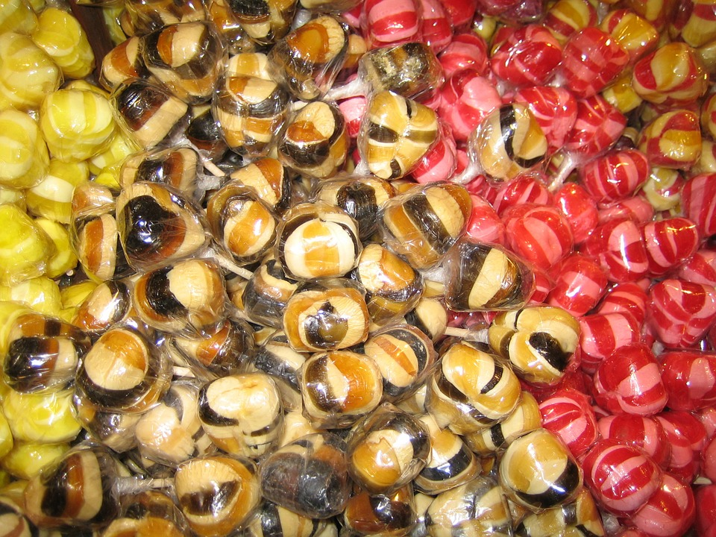
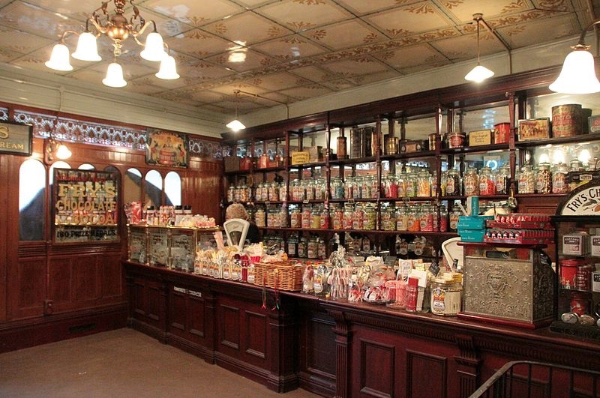
“My mother gives me pocket money for doing chores. She tells me to save it but I’d rather buy sweets at Mr. Brown’s shop on my way to school. I really like the toffees, liquorice and lots of chocolate!”
Sweet Treats
On his walk to school, Archie stops to buy a bag of chewy toffees from Mr. Brown at the corner shop…

Slide 11
On the front of this penny from 1879 is the head of Queen Victoria with a rose. On the other side of the coin is the seated figure of Britannia holding a palm branch.
Coin: New Zealand penny 1879 – obverse, [1999x2.150]. Auckland Museum, NZ.
A photograph of the interior of a confectionery store, taken around 1910.
Confectionery shop. Wakelin, S: Unidentified photographs. Ref: 1/2-103470-F. Alexander Turnbull Library, NZ. /records/23112213
An advertisement for an award-winning confectionery store in Colombo Street, ca. 1883-1890.
William Mouldey (Firm): Ref: Eph-B-CONFECTIONERY-1885-01. Alexander Turnbull Library, NZ. /records/23106082

Slide 12
Going to School
“My teacher is called Mr. Jones. He doesn’t like talking or dirty hands. The children in my class are older and younger than me. I like maths and playing games like cricket and rugby. But I hate getting lots of homework.”
When Scipio arrives at school, he is greeted by his friends and they quickly find a place to sit inside the classroom…
“My teacher is called a grammaticus and I go to his house for my lessons. School begins early in the morning but we usually finish at lunch time. My favourite subjects are Greek and poetry. In class we do lots of speeches…which makes me nervous.”
Archie’s friends are waiting at the school gate when he arrives. They all run towards the classroom, but are told off by a grumpy teacher for making too much noise…

Slide 13
A stylus like this was designed for use on wax-coated writing tablets. Many styli have been found in London, especially in areas of water, where they appear to have been deliberately placed as offerings to a divinity.
Stylus (JLMC 163.78). Circa 1st or 2nd century CE. UC James Logie Memorial Collection.
A Roman writing tablet was made from wood and wax was poured inside the frame. The pointed end of the stylus was used for writing into the wax, while the flattened end erased mistakes.
Wax tablet and Stylus (Replica). Greek/Roman period. Wikimedia Commons.

Slide 14
School master Clement Lester Wiggins teaching a class of boys at Christ’s College, Christchurch, around 1903.
Group of boys and school master C L Wiggins, Christ's College, Christchurch. Ref: 1/1-005236-G. Alexander Turnbull Library, NZ. /records/22879442
A group of unidentified school children and teachers including preschool to senior pupils, probably in Christchurch, ca 1905-1926.
Photograph: Maclay, Adam Henry Pearson, 1873-1955 :Negatives. Ref: 1/2-185220-G. Alexander Turnbull Library, NZ. /records/30112614
This slate has a sponge and pencil attached. A child would write on the slate with the pencil and erase words with the sponge.
Slate, 1800s, by National School Slate Company. Gift of H. Wollerman, 1965. CC BY-NC-ND 4.0. Te Papa (GH002410)

Slide 15
“I enjoy going to the baths (thermae) after school where there are lots of things to see and do. It is very noisy because everyone comes here to wash themselves. There are cold, warm and hot baths. We use a strigil and olive oil to clean ourselves.”
“Oh no! Not a bath! I hate having my bath after Mary and Henry. The water is already dirty…yuck! My mother makes the soap herself and it always smells funny. Some of the children in my class go to the baths in town but my mother says it’s cleaner in the tin tub!”
Bath Time
When Archie returns home from school, his mother has a nice warm bath waiting for him in the kitchen…
“Bye! See you tomorrow!” After school has finished, Scipio walks with his attendant to the baths to meet his father…

Slide 16
A greenish blown-glass bath-oil bottle with a folded rim, and a short neck. The oval body has two dolphin handles attached and a slightly concave base.
Oil Bottle (1877,0714.1). 3rd century. The British Museum.
A strigil was used by the Greeks and Romans to scrape dirt and impurities from the skin when bathing.
Bronze strigil with a stamped inscription. (1824,0482.1). The British Museum.

Slide 17
Baby in a tin tub in a tent. Children were usually bathed outside or in front of the kitchen range.
[Bathtime], Mackay, Mary Frances, 1887-, photographer, ca. 1917,PH-2007-1-12 Auckland Museum, NZ.
Edith Fell bathing her daughter Phyllis in a tin tub watched by her sister, Sylvia Fell. Photographed in 1889 by Charles Yates Fell.
Saturday night, Wellington. Ref: PA1-q-075-28-1. Alexander Turnbull Library, NZ. /records/22907747

Slide 18
“Mmm…delicious! Tonight we are having fish and vegetables for cena. Our slave Agata adds herbs, olive oil and garum, to make it extra tasty. We are having my favourite, a fig and apple dessert! But I’ll have to sit quietly at dinner or else…”
“We have our dinner in the evening because we are at work and school but some people have their dinner at lunchtime. We are having lamb chops, vegetables and rice pudding for dessert. Sparky wants some too, but we have to say grace first!”
Eating Dinner
When Scipio and his father return home from the baths they can smell that dinner is nearly ready…
Once Archie has finished having his bath, his sister Mary begins setting the table for dinner…

Slide 19
Cutlery was not widely used by the Romans as dishes were often prepared as finger food. This spoon has a shallow bowl and a handle which tapers down towards a point. The spoon may have been tin-plated to make it appear like silver.
Bronze Spoon (JLMC 228.18), ca. 2nd century CE. UC James Logie Memorial Collection.
A fish-plate with a red design on a black background, and white outlines. It has a round edge and a circular wave-pattern in the centre. The fish include a red mullet, a sea-perch or bass, a small squid, a sargus and a cuttle-fish.
Fish-plate (1872,0603.1). 360-330 BCE. The British Museum.

Slide 20
This is a set of bone-handled metal knives and forks for a child. The blades are stamped ‘FOR A GOOD CHILD’.
Child’s cutlery (col.1390). Circa 1800s. Auckland Museum, NZ.
Photographed by Lesley Adkin, this woman is peeling potatoes and chopping cauliflower on a wooden kitchen table.
Preparing dinner , 28 December 1913, by Leslie Adkin. Gift of G. L. Adkin family estate, 1964. Te Papa (A.008597)
A small porcelain plate such as this would be used for bread or side dishes.
Plate, 1800s, England, maker unknown. CC BY-NC-ND 4.0. Te Papa (CG000607)

Slide 21
Playtime
“Come back, Sparky! I love to play catch with Sparky but we have to go to the playground because we might ruin the vegetable garden. I like to play marbles and fly kites. In the weekend, I’m going to Ballantynes to get a tin soldier.”
After he has finished eating, Scipio is allowed to spend some time playing with his toys and his pets, Titan and Ajax…
“C’mon Titan, let’s go! I love to throw a ball to my dog or play with my knucklebones. My sister plays with her dolls but I’d rather have pretend sword fights and swap gladiator figurines with my friends.”
As it was still light after dinner, Archie was able to play outside with Sparky until it started to get dark…

Slide 22
The game of knucklebones is thought to have originated in Egypt and was played using the ankle bones of sheep. It is comparable to the modern game of jackstones.
Glass and copper knucklebones (HT970-974). John Hopkins Museum.
A hoplomachus was a type of gladiator who was armed to resemble an ancient Greek hoplite. It is thought that bronze figurines like this were sold near the arena as souvenirs.
Gladiator (Hoplomachus) (1958.4) Antikensammlung der Staatlichen Museen zu Berlin. Fotograf/in: Ingrid Geske.
This ivory doll was found inside the coffin of an eight-year-old girl in Rome.
Roman Doll (168191). 2nd century CE. Palazzo Massimo alle Terme / Public domain

Slide 23
A toy horse on wheels, made of papier-mâché. The toy could be pulled along by its string.
Toy Horse, circa 1900, maker unknown. Gift of the Guard family, 1991. CC BY-NC-ND 4.0. Te Papa (GH003812)
The game of marbles was known in the ancient world as nux or nuts. These glass marbles of different sizes were made in the 1800s.
Marbles, 1800s, maker unknown. Gift of Mrs Phyllis MacDonnell, 1964. CC BY-NC-ND 4.0. Te Papa (GH002372)

Slide 24
Marble Game
1. Draw a large circle, usually about 5 to 10 feet across, and place 13 marbles in the centre, spaced 3 inches apart to form a cross.
2. Using a designated shooter marble, players take turns shooting from outside the circle and trying to hit a target marble out of the ring while keeping the shooter marble inside the ring. If the shooter misses, the player picks up his shooter marble and his turn is over. If the shooter scores a hit but the shooter marble rolls out of the ring, the player keeps any marbles that rolled out, including his shooter marble, and his turn is over. If the shooter scores a hit and the shooter marble stays inside of the ring, the player shoots again from the spot where the shooter marble came to a stop.
3. For each new turn, a player shoots from anywhere outside the ring.
4. The person who collects the most marbles is the winner.
Knucklebones
Equipment
All that is needed to play the game of Knucklebones are five small stones or knucklebones. Alternatives to the knucklebones or stones can be pretty much anything of a similar size - originally sheep knucklebones were used.
How to play
To play this game, take your knucklebones in one hand and throw them into the air. Try to catch as many as you can on the back of your hand. If you don’t manage to catch all of the knucklebones, pick up those that have fallen on the ground while still balancing the other knucklebones on your hand. The winner is the person who catches all the knucklebones on their hand with the least number of throws.

Slide 25
Roman Pets
“Most of my friends have pets and there are always new animals to meet on the street! A boy in my class at school has a pet monkey but my father says that they are dangerous and it wouldn’t be allowed inside the house like Ajax and Titan.”
Scipio loves to spend lots of time outside playing with Ajax and Titan and making new furry friends…

Slide 26
A young child, who is known as the ‘little refugee’, wears a hood and carries a small dog. This statuette was found in Geronikon, Asia Minor (modern day Turkey).
Marble Statuette of a Boy with a Dog (4385). 1st century BCE. National Museum of Athens. Marsyas / CC BY-SA (creativecommons.org/licenses/by-sa/2.5)
A Maltese dog sits in a small shrine on this marble gravestone. The inscription reads: “To Helena, foster daughter, the incomparable and worthy soul.” Since the child was not shown with the pet, it may indicate that Helena was not a high-born Roman.
Grave Stele For Helena (71.AA.271), 150-200 CE. J. Paul Getty Museum.

Slide 27
Prayers
“I’m just about to say my prayers before bed. My family goes to an Anglican church on Sundays. My mother reads the Bible to me at home and I go to Sunday School with lots of my friends. We believe that one God looks after everyone.”
In the evening, Scipio’s mother and father say religious prayers and offer fruit at the lararium for protection…
“In the evening my parents offer oil and fruit to the gods at a lararium in our house. My father says that these gods will protect the house and our family. We believe that there are many gods and that they all look after us.”
Before he goes to sleep, Archie kneels beside his bed to say his prayers…

Slide 28
The lararium altar was the place in the Roman home where offerings and prayers were made to the gods. The painting on this altar has two dancing lares (guardian spirits) either side of the genius (spirit of male head of the household) holding raised horns.
House Altar in the Painted House (Replica). Wikimedia Commons.
A patera was a shallow bowl used for serving food or drink at dinner parties or for pouring libations at religious ceremonies. This patera has a wolf’s head on the handle.
Roman Bronze Patera (JLMC 227.18) 1st century BCE – 1st century CE. UC James Logie Memorial Collection.
Bronze figure of a lar, (a protective spirit of a house), holding a cornucopia and a libation bowl.
Lar Figure (1824,0438.1) 1st century CE. The British Museum.

Slide 29
A patterned leather hymn book with gold lettering. Inscribed: “To dear little Geoff, on his second birthday, with his Grandpa’s love. A. M. Simla, Mt Eden, Auckland. 23 March 1907.”
Hymn Book (02017.110), 1900s. Howick Historical Village.
A sampler made by Maria Pocock. A sampler is a piece of embroidery or cross-stitching that demonstrates or tests needlework skills.
Sampler, 1823, by Maria Pocock. Gift of Mrs A R Tosswill, 1967. Te Papa (PC001521)

Slide 30
Bedtime
“My sister Mary has her own room but I have to share with my brother Henry. I have lots of toys in my room and a big wardrobe for my clothes. My mother cleans my bedding each week, but I have to empty my chamber pot every morning!”
By the end of the day, Scipio is very tired and it doesn’t take him long to fall asleep…
“I have to share a small cubicula with my sister. This room is at the back of the house because it’s quiet. I don’t share a room with my parents like some children. My bed looks like a couch and has a feather mattress. ”
After saying his prayers, Archie climbs into bed and his mother reads him a chapter from his favourite book, ‘Treasure Island’…

Slide 31
A small bedroom in a Roman domus usually opened on to an atrium. The room could have been used for different purposes. There is no evidence of children’s bedrooms in Roman houses.
Cubicula (Replica). Wikimedia Commons.
A circular oil lamp with a large filling hole and a ring handle, decorated with two wreathes. In ancient Rome, clay lamps were filled with fish or olive oil and were used to provide light.
Roman Lamp (JLMC 191.04). 1st century CE. UC James Logie Memorial Collection.

Slide 32
Written in 1881, Treasure Island told of the adventures of Jim Hawkins and his search for the buried treasure of an evil pirate.
Treasure Island (OCLC: 361881), RL Stevenson, 1911. Wikimedia Commons.
Medium sized copper lamp. Oil lamps were used as an alternative to candles before electric lighting.
Lamp (2009.111.1) 1900. Howick Historical Village.

Slide 33
Goodbye
Scipio and Archie are sad to say goodbye, but they have to go and get ready for another busy day tomorrow…
“Thanks for joining us! We hope that you learned lots about our lives and the fun (and not so fun) things we do! Bye! Vale!”

Slide 34
Scipio’s Glossary
Atrium – an open roofed entrance hall
BCE - Before the Common Era or before the birth of Jesus Christ, when the Christian calendar starts counting the years as BC
Bulla – a locket worn around the neck to protect against evil spirits
CE – Common Era or a period from the birth of Jesus Christ, when the Christian calendar starts counting years as AD
Cubicula – a small private bedroom in a Roman house
Domus – a house occupied by wealthy families
Garum – a fermented fish sauce
Gorgon – a mythical creature from Greek literature with protective powers
Gladiator – a man trained to fight other men or wild animals for entertainment
Grammaticus – a professional teacher of language and literature
Hoplite – an ancient Greek soldier with a heavy armour and helmet, a small rounded shield, a spear and sword
Iron Age – a period when weapons and tools came to be made of iron
Knucklebones: a game traditionally played with the ankle bones of a sheep
Lararium: a shrine to guardian spirits of the Roman household
Libation: a drink poured as a sacrificial offering to a Roman god or goddess
Rameses the Great – the third Egyptian king of the 19th ruling family of Egypt
Salvē – hello or welcome (Latin)
Strigil: a curved instrument used to scrape dirt and oil from the skin
Taberna – a single room shop
Thermae: a public bathing complex
Toga – a loose outer garment, made of cloth and wrapped around the body
Vale – Goodbye (Latin)

Slide 35
Archie’s Glossary
Anglican – a Christian who is a member of the Church of England
Ballantynes – an iconic department store in Christchurch (New Zealand). Established 1854
Britannia – an ancient term for Roman Britain
Chamber Pot – a bowl kept in a bedroom and used as a toilet at night
Cross – a necklace worn by Christians as an expression of their faith
Knickerbockers – loose fitting trousers gathered at the knee or calf
Laundry Copper - a heated boiler used to whiten clothes
Liquorice – a black sweet flavoured with the root of the liquorice plant
Porridge – a dish of boiled oatmeal in water or milk
Rice Pudding – a dish made from rice mixed with water or milk
Sunday School – classes held on a Sunday to teach children about Christianity

Slide 36
Credits
Created by Nicole Pepperell, Teece Museum intern 2019
Edited by Natalie Looyer and Terri Elder, Teece Museum
Model: Will Fisher, with thanks also to Miriam Fisher
Costuming: Naomi van den Broek and Petticoat Lane Costume Hire
Photographer: Corey Blackburn, University of Canterbury
With thanks also to Alex van den Broek, CCC Tūranga AV Studios

